Slide 1
Galant-JS
Final Project Hand Off
Team #43:
Christina Albores, Vitesh Kambara, Julian Madrigal, Neha Ramesh, Minghong Zou
Notes:
Hello we are team 43 Galant presenting OPR2, we have Julian, Vitest, Neha, Minghong and myself Christina
Christina

Slide 2

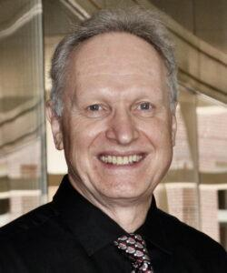
Introduction & Agenda
01
Project Recap
02
Live Demo
03
Current Progress
C
04
Code Summarization
05
Testing
Dr. Matthias Stallmann
Galant-JS: a web based graph animation software that focuses on visualizing & implementing algorithms through graphs
06
Conclusion + q&a
Notes:
Hello! We are the Galant team working with Dr. Stallmann.
Our sponsor Dr. Stallmann is a Graduate Professor that specializes in Graph Algorithm research.
We are working with him to develop a web based graph animation software that focuses on visualizing & implementing algorithms through graphs.
The Agenda includes the following:
Christina

Slide 3
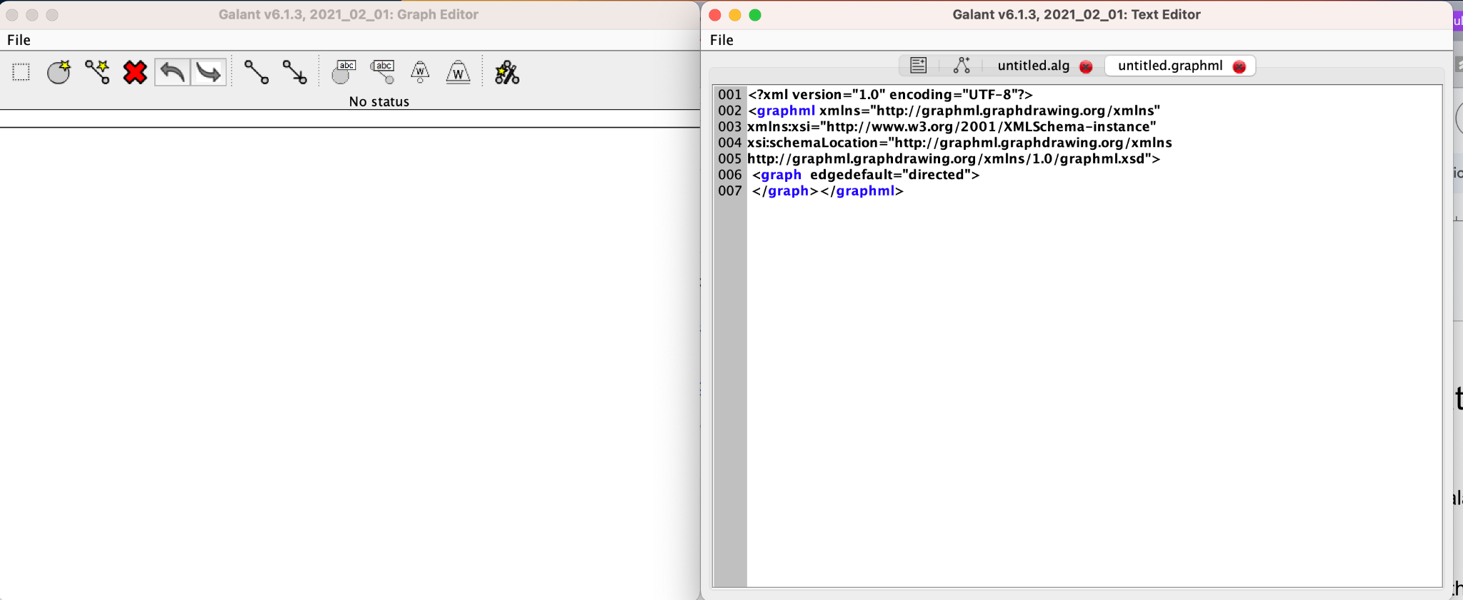
Project Recap — Review of Problem Statement
Problems:
Requires users to have git, Apache Ant, and access to a Java compiler
Complex and has unnecessary features
Needs something more lightweight and accessible
OLD DESIGN
Notes:
As a recap,
The problem our sponsor was having is that the Java version of Galant requires users to have git, Apache ant, and access to a Java compiler.
It's complex and has many unnecessary features for end users and Dr. Stallmann wanted something more lightweight and accessible.
Christina

Slide 4
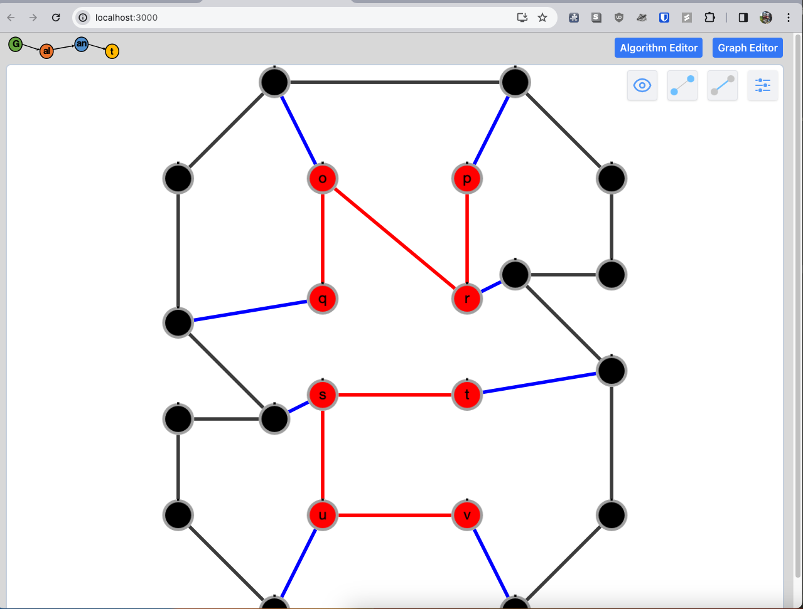
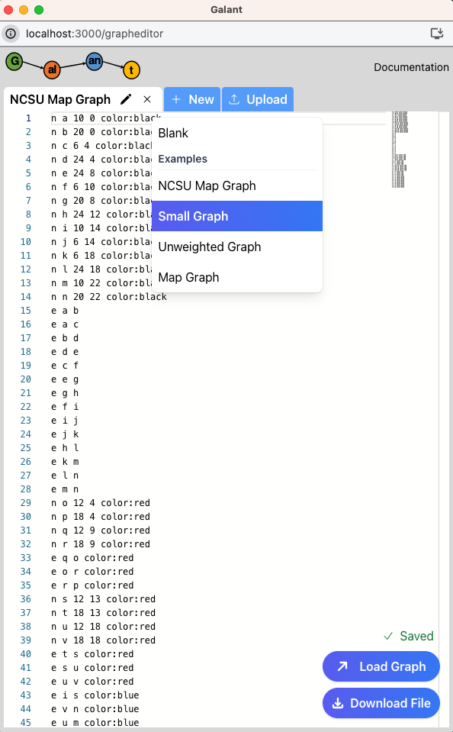
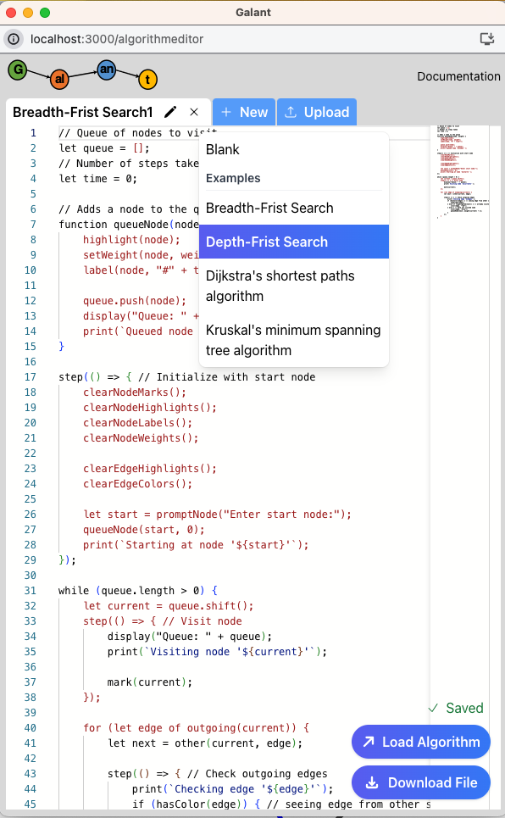
Project Recap — Proposed Solution/Enhancements
NEW DESIGN
Notes:
To address this problem, Galant-js, was developed by previous Senior Design Teams.
Building on the previous team's work, we are enhancing GalantJS by incorporating more key features from the Java version, which will be discussed later.
Minghong

Slide 5
Current Progress - Requirements
UC 0A: Load in an Algorithm Example
UC 0B: Load in a Graph Example
UC 1: Algorithms Use and View Offline
UC 2: Synchronizing the Graph and Graph Text
UC 3: Animation features
UC 4: Node and Edges Attributes
UC 5: Keyboard Shortcuts
UC 6: Scale .sgf files in Algorithm Editor
UC 7: Graphs Persist on Webpage Refresh
UC 8: Skip to End Functionality
UC 9: Preference Panel
CA, VK, JM, NR, MZ
Notes:
Green is completed
Red we got rid of
With Dr. Stallmann's approval, we dropped UC1 since it would require refactoring a majority of the codebase.
As an example, UC0A
Team Contributions
Minghong

Slide 6
Project Recap — Timeline
Enhancing Animation
Requirements, Design, Research
UC3, UC4, UC5
Iteration 0
Iteration 2
Feb 27,2024
April 23, 2024
March 30, 2024
Iteration 1
Iteration 3
UC0, UC1, UC2
UC6, UC7, UC8, UC9
Syncing Editors and Loading Examples
Use of .sgf files, and quality of life updates
Notes:
In summary, we have finished iteration 0 which was Requirements, Design, Research….We have finished Iteration 1 which dealt with Syncing Editors and Loading Examples and testing these use case…..And we have finish iteration 2 which will improve animation functionality. Now we are working on Iteration 3 which are

Slide 7
Galant-JS Live Demo
Actions occurring in the video, chronologically:
Load graph (UC0B)(UC7)
Change/Sync Node and Edge Attributes (UC4)(UC2)
Load Algorithm (UC0A)
Step through algorithm (UC3 - Explain the animation details during this process)
Skip to the end of the algorithm (UC8)
Use shortcuts (UC5)
c(controls), e(edge settings), n(node settings), p(preference panel) (UC9)
Export graph (UC3)
Upload a .sgf file (UC6)
Notes:
Christina

Slide 8
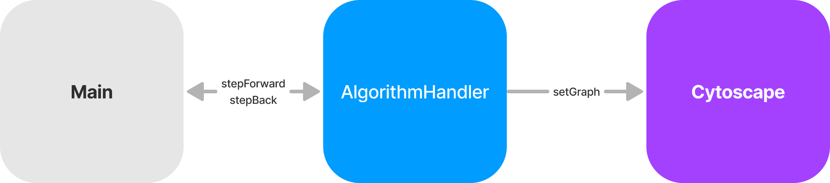
Previous Overall View of Design
AlgorithmHandler directly controls the graph display
Difficult to implement edit mode
Original Design
Rendering Graphs
CA, VK, JM, NR, MZ
Notes:
After completing the restructuring of galant’s files, we began analyzing the design of displaying a graph.
Vitesh

Slide 9
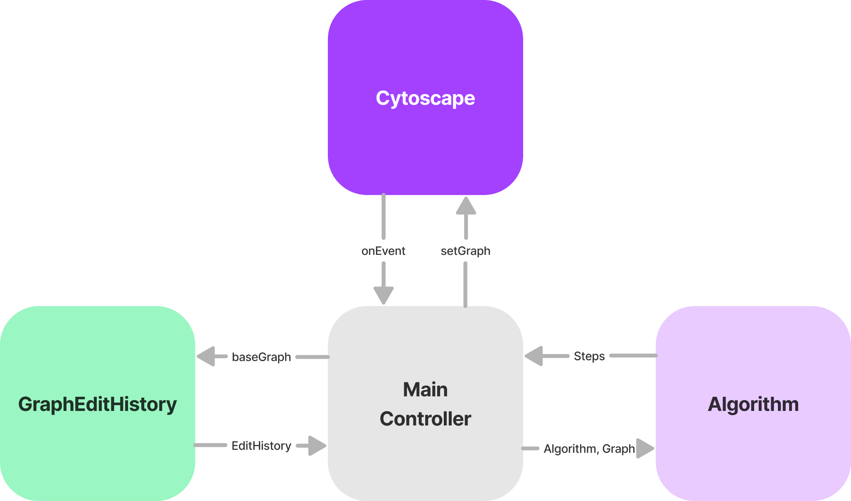
Overall View of Design
Updated Design
MainController handles context switching between three modes
Easily switch the current graph view based on active mode
CA, VK, JM, NR, MZ
Notes:
4 modules
Cytospace, maincontroller, algorithm, graphEdithistroy
Vitesh

Slide 10
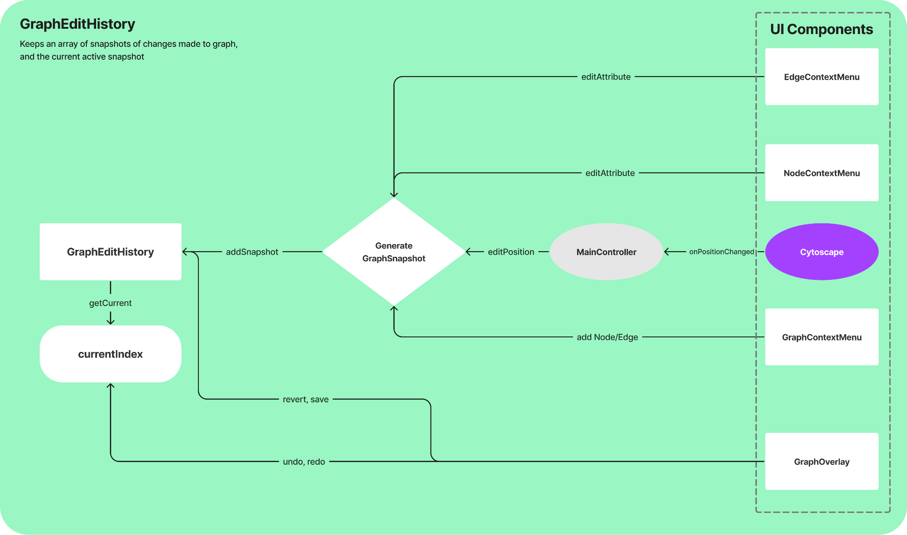
Design (GraphEditHistory)
JM
Notes:
Julian

Slide 11
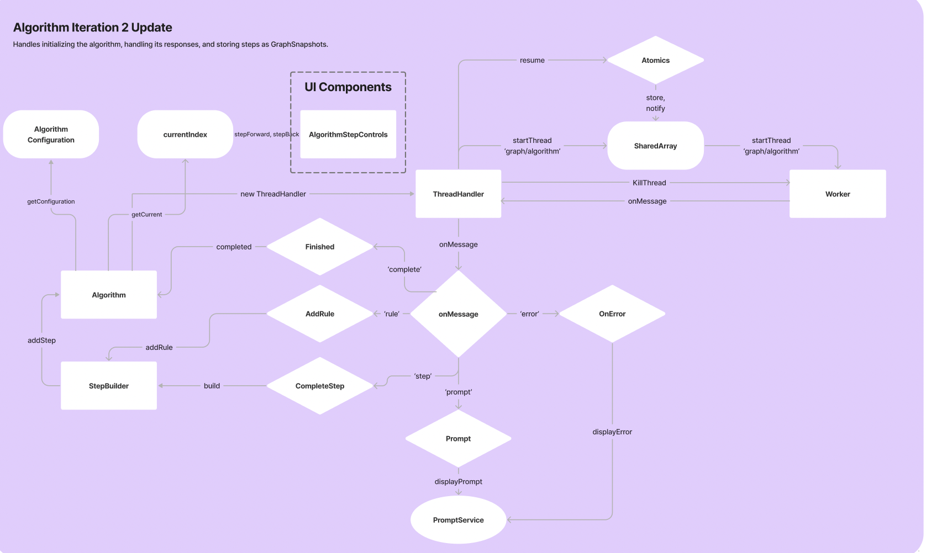
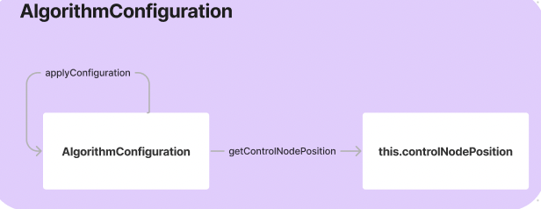
Design (Algorithm)
JM
Notes:
We added our algorithm control method algorithmConfiguration that allow us controlNodePosition
Julian

Slide 12
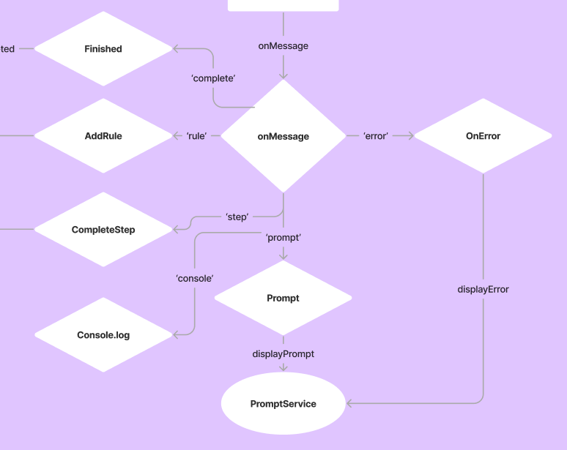
Design (Algorithm)
JM
Notes:
Julian

Slide 13
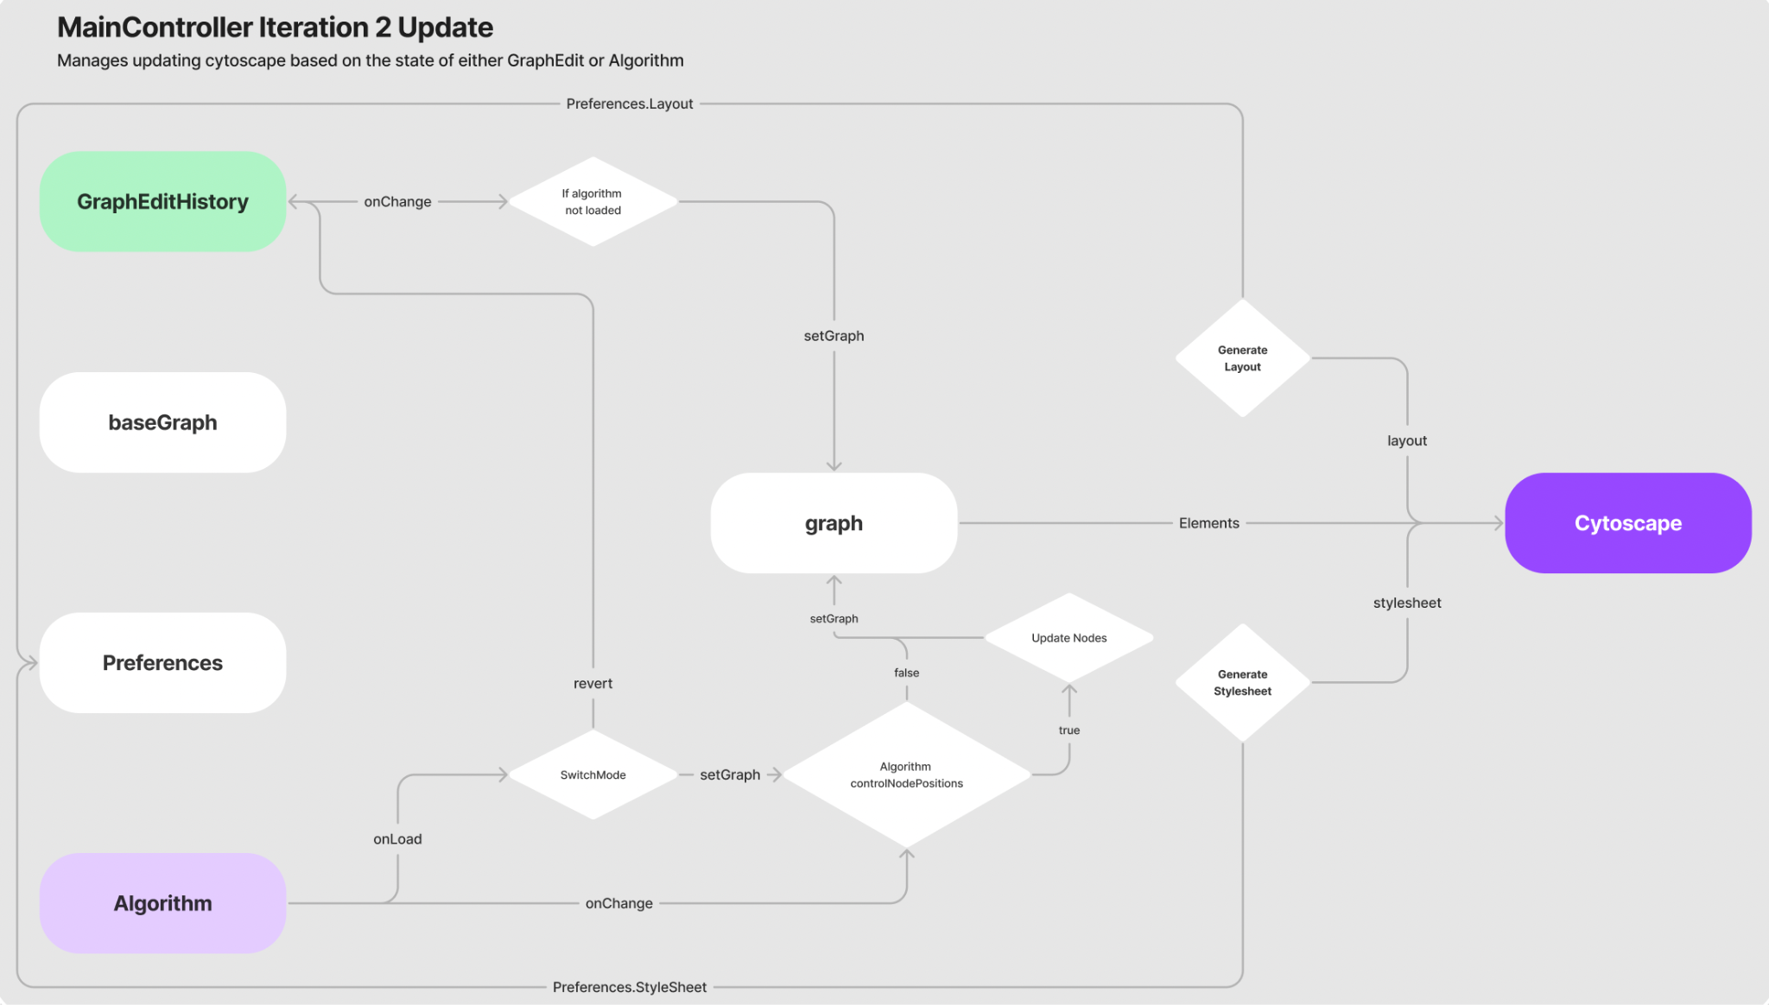
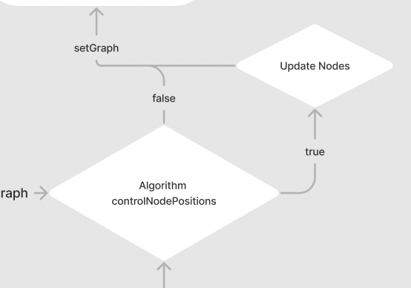
Design (MainController)
JM
Notes:
MainController we add a step AlgorithmControlNodePositions that allow us to update node position or not
Neha

Slide 14
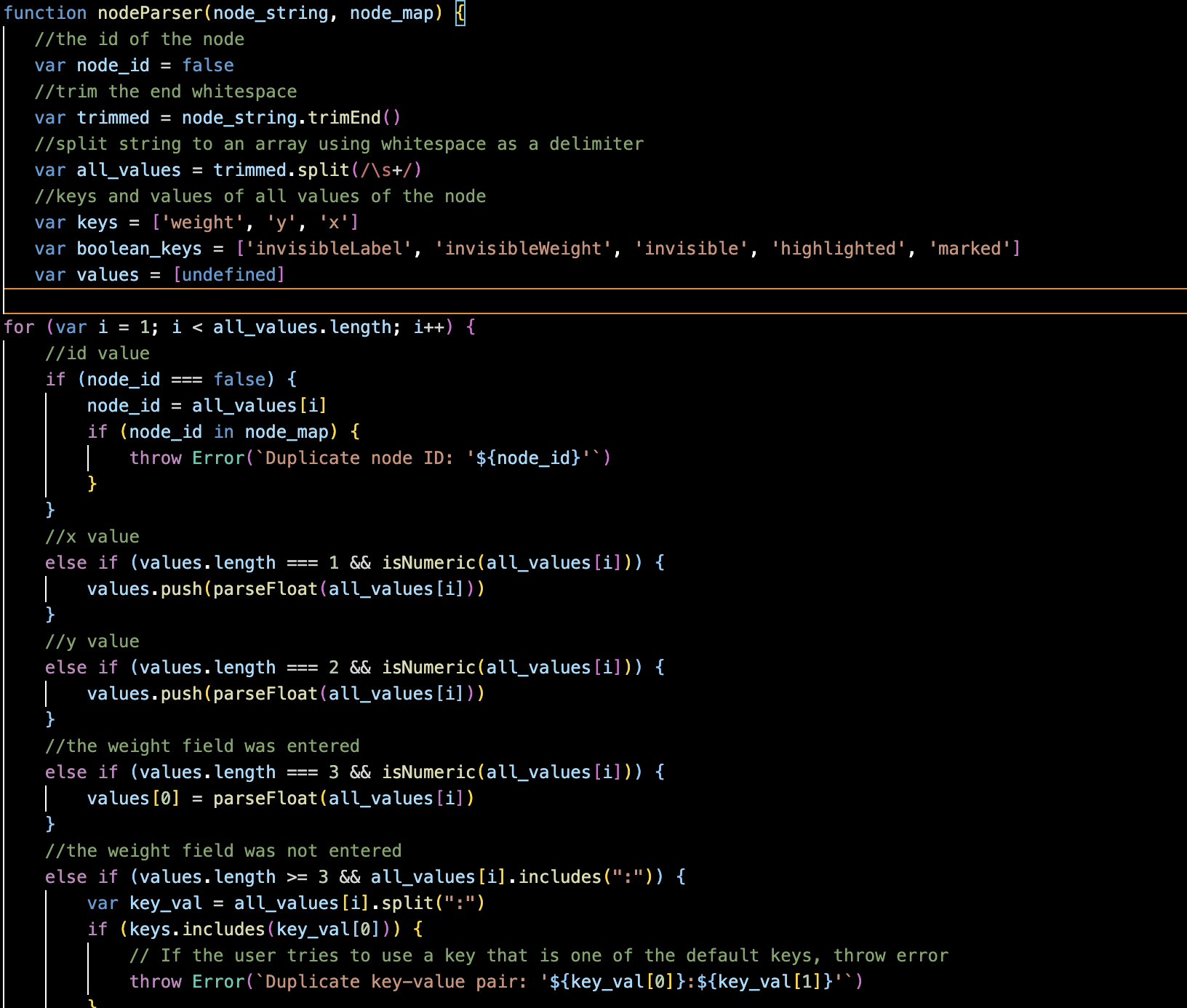
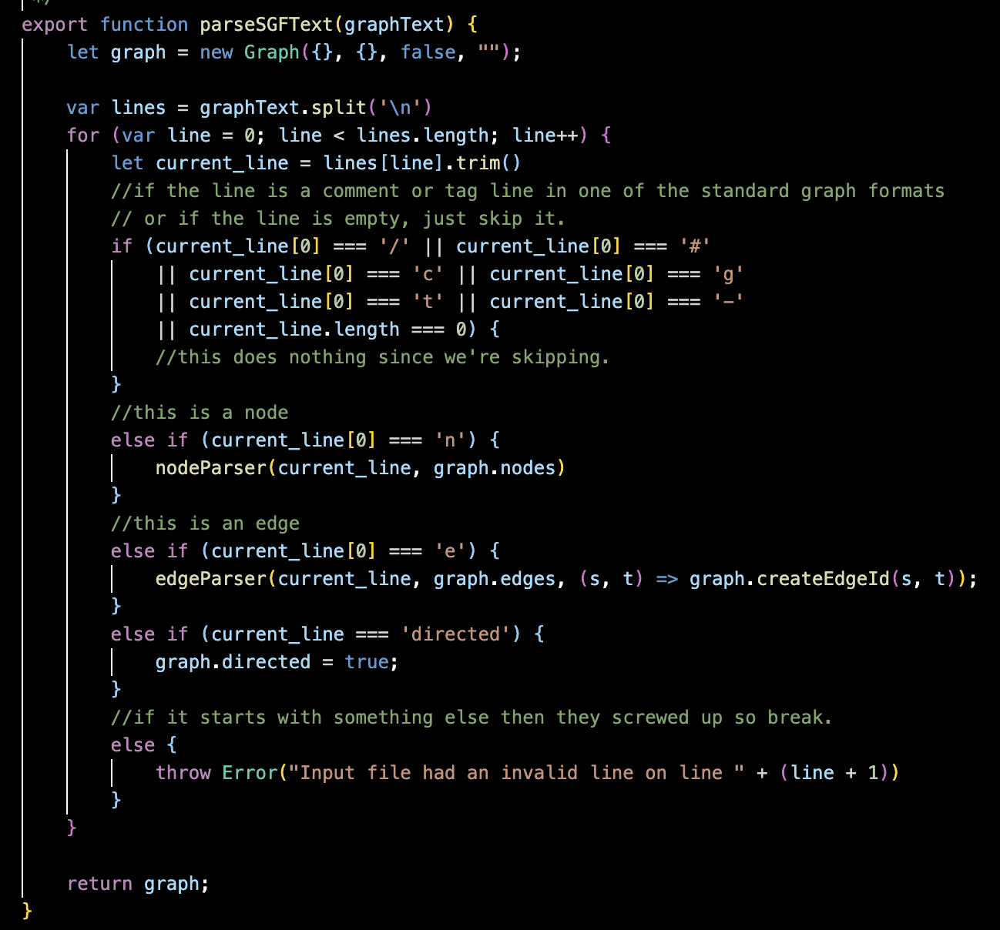
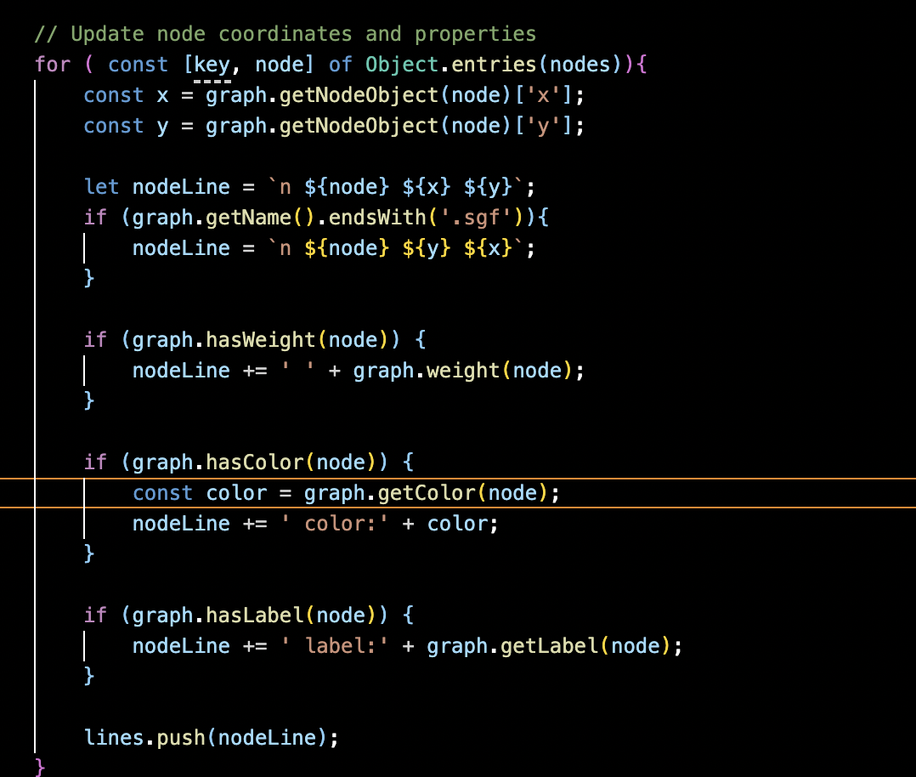
Code Summarization - UC6 .sgf Files
Notes:
Neha

Slide 15
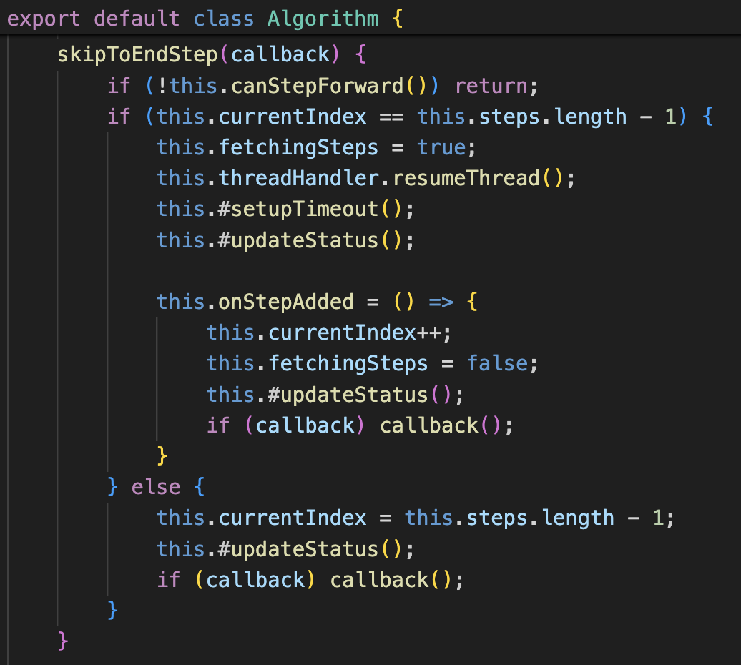
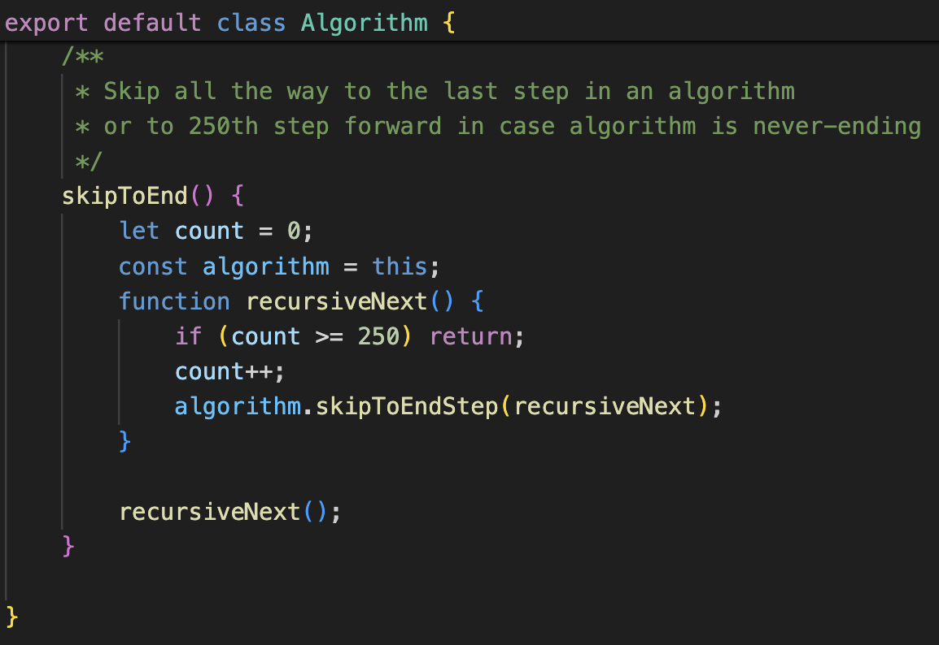
Code Summarization - UC8 Skip to End
Notes:
Vitesh

Slide 16


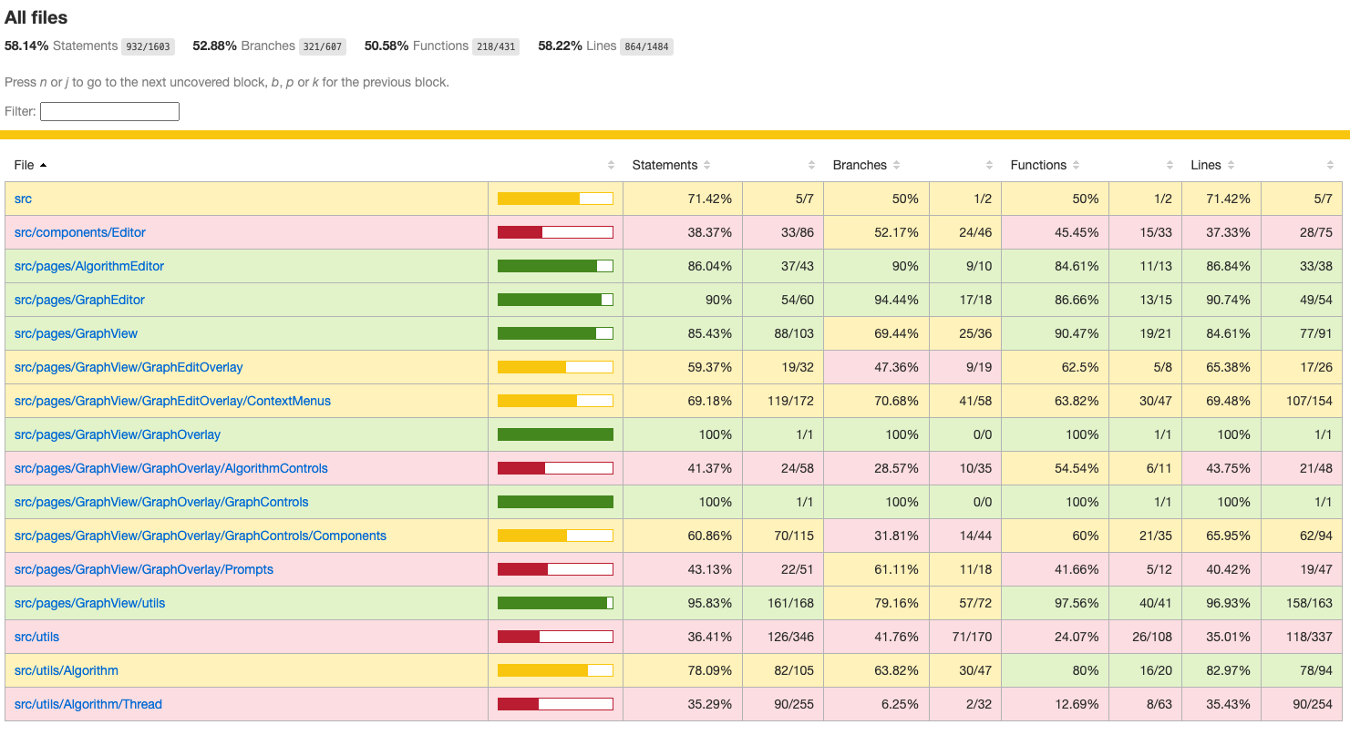
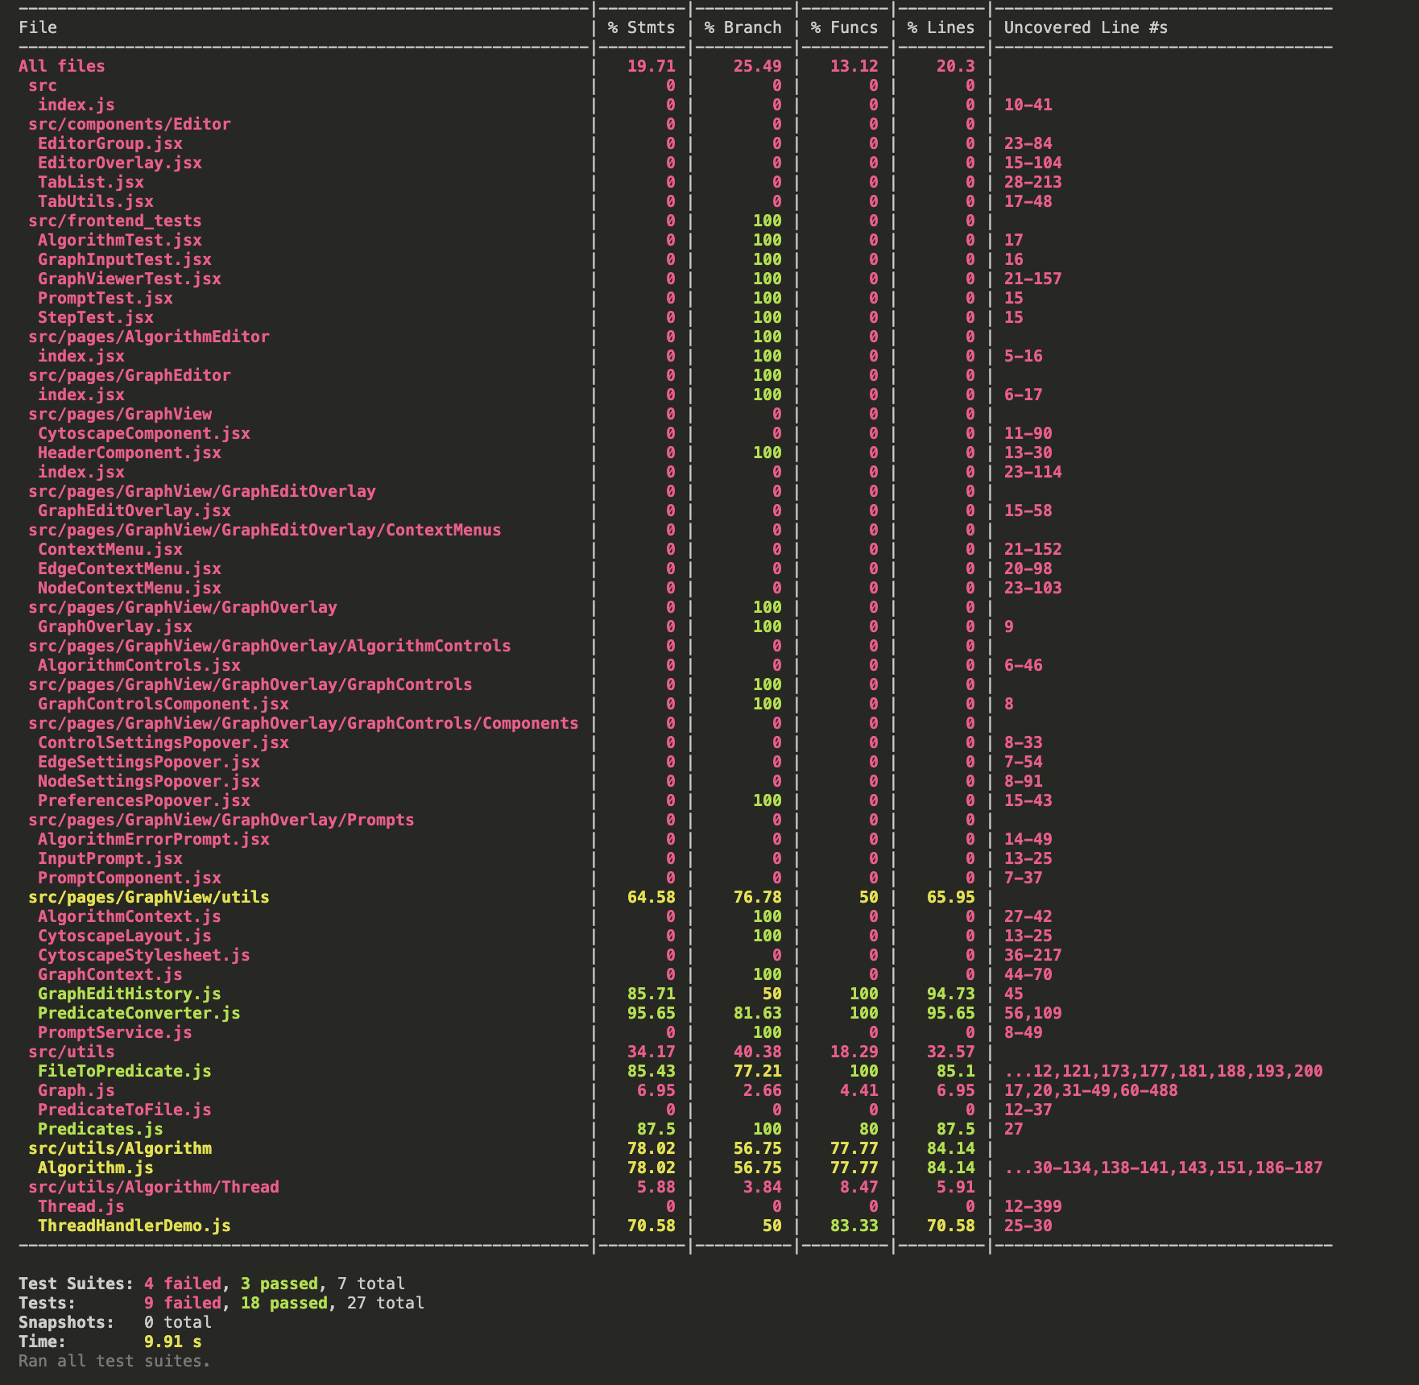
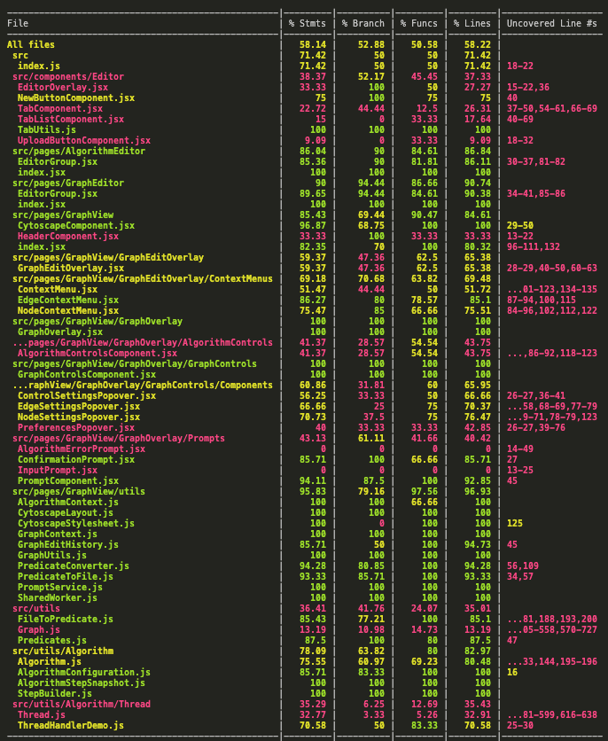
Current Progress - Testing
System Test Plan
UC6 | UC8
uploadSgfFile | finiteSkipToEnd
editSgfFile | infiniteSkipToEnd
Aiming for Statement Coverage 70% and Branch Coverage 50%
CA, JM, NR, VK, MZ
Notes:
Vitesh

Slide 17
Action Steps & Conclusion
Enhancing Animation
Requirements, Design, Research
UC3, UC4, UC5
01
Finish FPR sections
Finish FPR
Iteration 0
Iteration 2
02
Development, User, Deployment Guides
Finalize Guides
Feb 27,2024
April 23, 2024
March 30, 2024
03
Attend Posters and Pies
Iteration 1
Iteration 3
Finalize Poster
UC0, UC1, UC2
UC6, UC7, UC8, UC9
04
Add more testing and document all the files in the codebase.
Finish Testing
& Documentation
Syncing Editors and Loading Examples
Use of .sgf files, and quality of life updates
Notes:
To reiterate, we have finished Iteration 0 and Iteration 1 and we are moving on to work on Iteration 3 with deals with enhancing Animation Use Cases.
Vitesh

Slide 18
Suggestions for Future Teams
Reduce reliance of useEffect() for data transfer, especially for graph/SetGraph. Some drawbacks of this include the inability to determine when a new graph has loaded. This results in the need to use timeouts to estimate completion of loading to auto-fit.
Reduce reliance of third party extension cy-node-html-label and use Cytoscape’s functionality for labels. While this reduces possible customization, it is unneeded and introduces bugs as the extension is unmaintained.
For the sake of implementing more layered graph algorithms in GalantJS in the future, Dr. Stallmann would like to see algorithms having more control over the layout of the graph as opposed to the graph file/input.
Notes:
To reiterate, we have finished Iteration 0 and Iteration 1 and we are moving on to work on Iteration 3 with deals with enhancing Animation Use Cases.
Team

Slide 19
Thank You
Notes:
Vitesh

Slide 20
Questions?
Notes:
Vitesh

Slide 21
Guides & System Test Plan
Installation Guide
Developer’s Guide
User’s Guide
System Test Plan
Deployment Guide
Notes:
Vitesh

